Slide 1
Notes on Cloud Computing
Virtualization and Cloud Computing

Slide 2
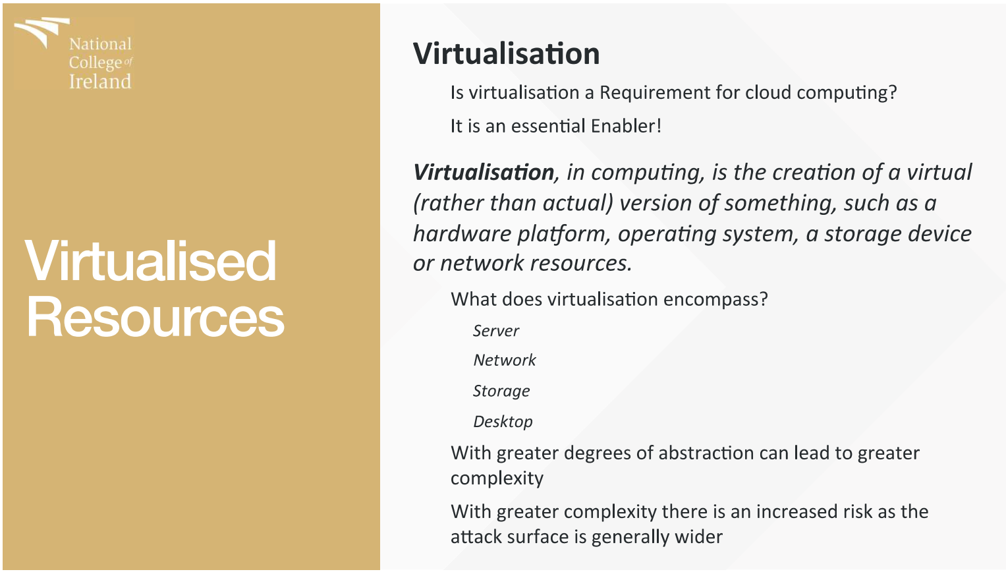
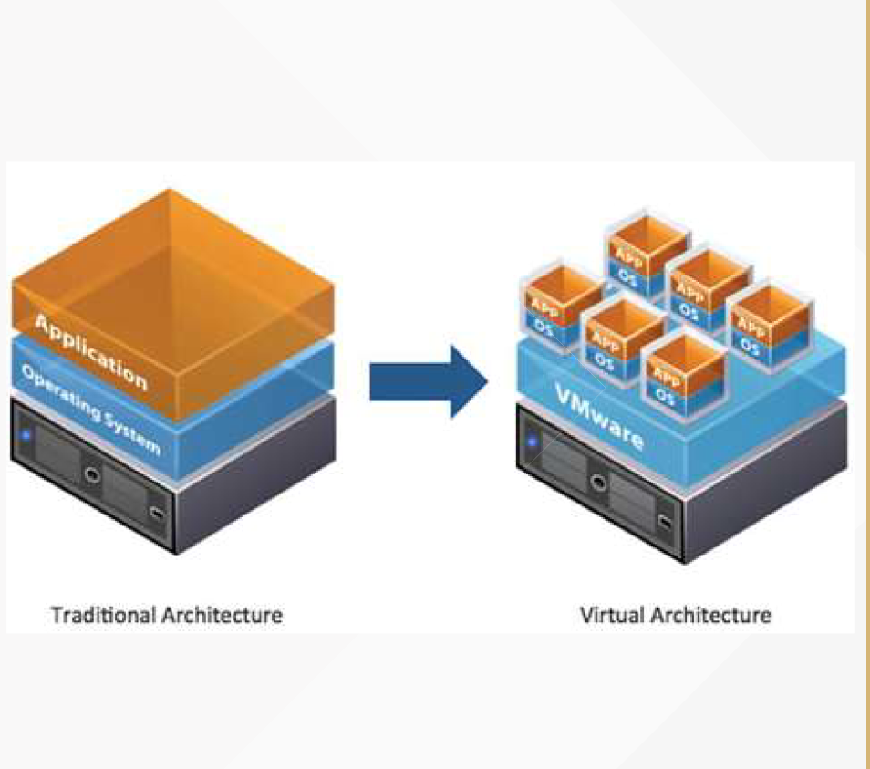
Virtualization

Slide 3
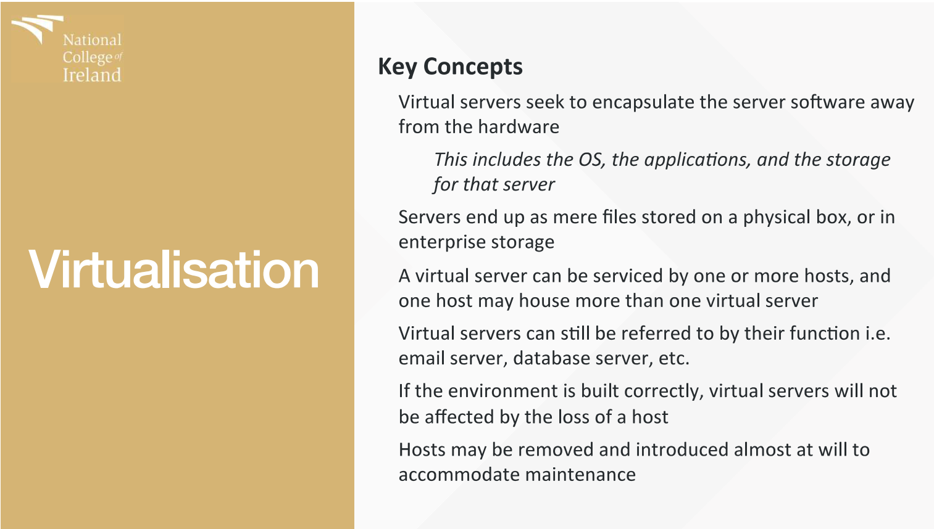
Key Concepts

Slide 4
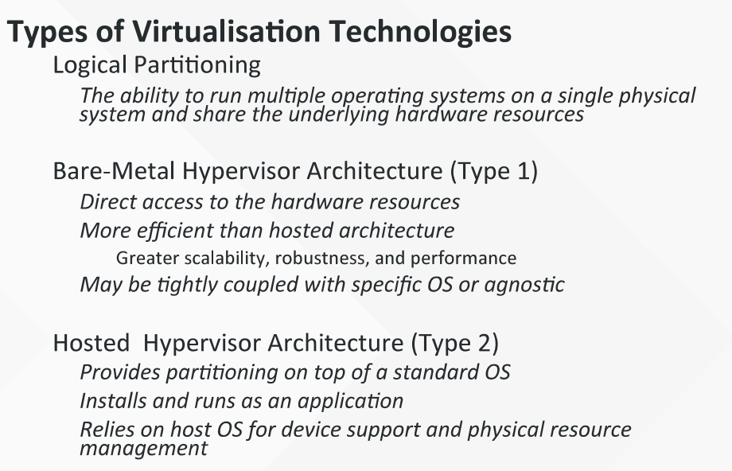
Types of Virtualization

Slide 5
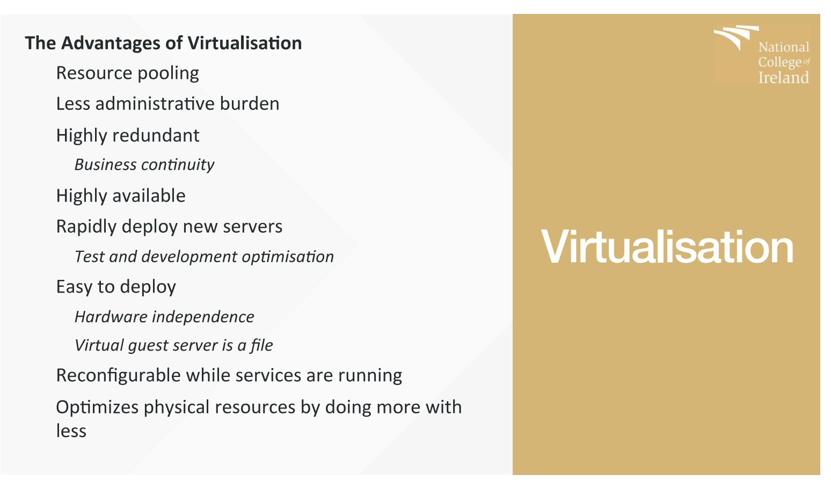
Advantages of virtualization

Slide 6

Recap : The Basics
According to the official NIST definition, "cloud computing is a model for enabling ubiquitous, convenient, on-demand network access to a shared pool of configurable computing resources (e.g., networks, servers, storage, applications and services) that can be rapidly provisioned and released with minimal management effort or service provider interaction."
What is Cloud Computing ??
Cloud computing is a Paradigm that allows On-Demand Network Access to Shared computing Resources.
A Model for Managing , Storing & Processing Data Online Via The Internet
https://www.nist.gov/news-events/news/2011/10/final-version-nist-cloud-computing-definition-published

Slide 7
Cloud Characteristics
On Demand Service
“ You use it When You Need It “
Network Access
“ Uses Internet As A Medium”
Shared Resources
“ Resources Are Pooled Together / Used By Multiple Clients”
Scalability
“ Allows Elasticity of Resources”

Slide 8
Cloud Service Types / Delivery Models
Platform
Infrastructure
Software
SAAS
PAAS
IAAS

Slide 9
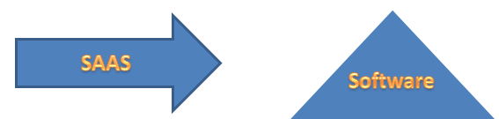
On Demand
Pay-Per-Use of Application Software to Users
Independent Platform
Don't need to install software on end devices
Runs a single instance of the Software and makes it available to multiple users
Makes Cloud Computing a lot cheaper than traditional methods
All computing resources for SAAS required to run the software are managed by the vendor
Accessible Via Web Browser or Lightweight Client Applications

Slide 10
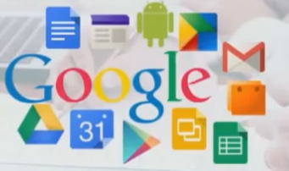
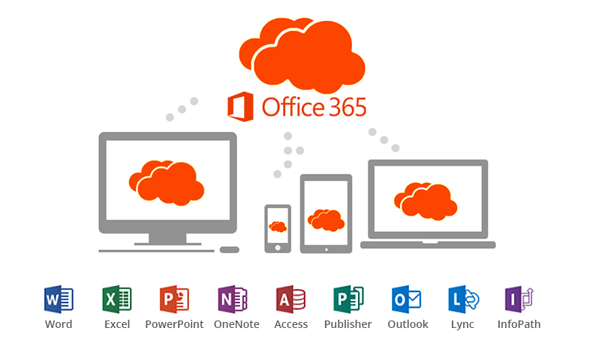

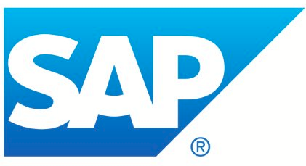
Products and Services of SAAS
CRM / ERP / Google Eco Sys
Pros:
Accessible from any platform
Work From Anywhere
Collaborative Working
Vendor Provided
Multi tennancy
Cons
Portability & Browser Issues
Internet Performance
Compliance Restrictions

Slide 11
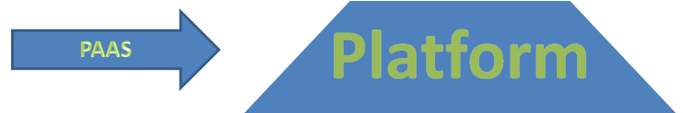
A Development Environment, made up of a programming language execution environment , An Operating System , A web server & A Database.
Encapsulates the environment where users can Build, Compile & run their programs without worrying of the underlying infrastructure.
In this Cloud Computing Model , You manage data & The application Resources, All other Resources are managed by the Vendor

Slide 12



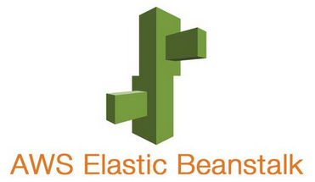
Products & Services of PAAS :
Dev Environments
Pros:
Cost Effective Rapid Development (Scalability)
Faster Market For Developers
Easy Development of Web Applications
Private & Public Deployment is Possible
Cons
Developers Are Limited to Providers Languages & Tools
Migration Issues : Vendor Lock In

Slide 13
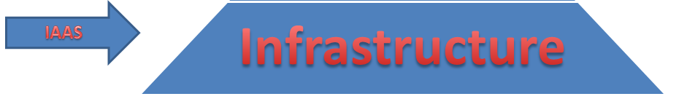
Offering Computing Architecture & Infrastructure, All computing resources but in a Virtual Environment. Enabling Multiple Users to Access Them.
Resources : Data Storage / Virtualization / Servers / Networking
Most Vendors are responsible for managing the above 4 resources.
The users or purchasers will be responsible for handling other resources such as : Applications / Data / Runtime / Middleware

Slide 14
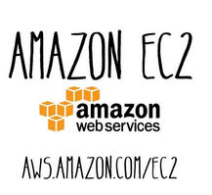

Products & Services of IAAS:
Pros:
The Cloud Provides the Infrastructure
Enhanced Scalability – Dynamic Workloads are Supported
IAAS is Flexible
Cons
Security Issues ( Tenants ) ( Noisy Neighbours ) (Shared Resources)
Network & Service Delays
(SLAs 99.98% Availability)

Slide 15
Cloud Service Types / Delivery Models
Platform
Infrastructure
Software
SAAS
End Customers
PAAS
Developers
IAAS
SysAdmins

Slide 16
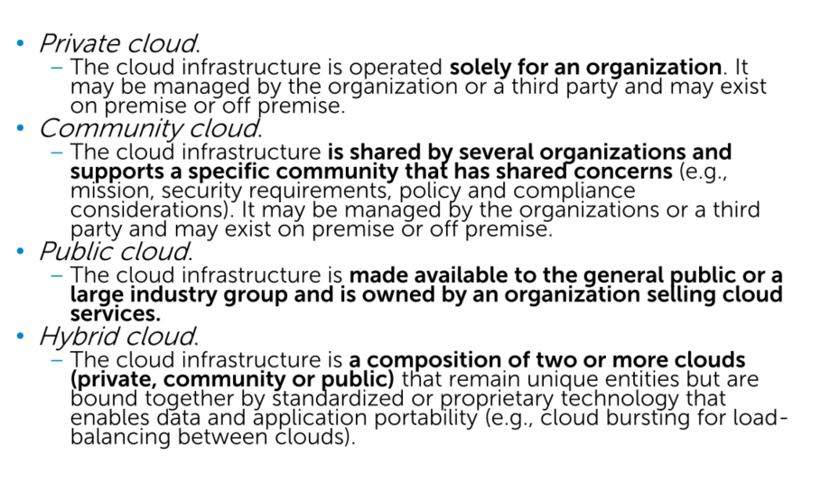
Deployment Models (NIST)

Slide 17
Big Players
AWS
IAAS & PAAS
EC2 / S3 / RDS / Elastic Bean / IoT
Apple Have significant presences in CC with the iCloud – Seamless integrations. Backup & Store. Access from anywhere
Microsoft
Offers IAAS / PAAS / SAAS
Enterprise SW and Dev Tools
Office 365 – SAAS
Google Cloud Platform
Universal Cloud for Google Eco Sys
Collaboration / Storage etc
IBM Private / Public / Hybrid Models of deployments. Provides full range of PAAS / IAAS / SAAS – Pay As You Go Model for businesses.

Slide 18
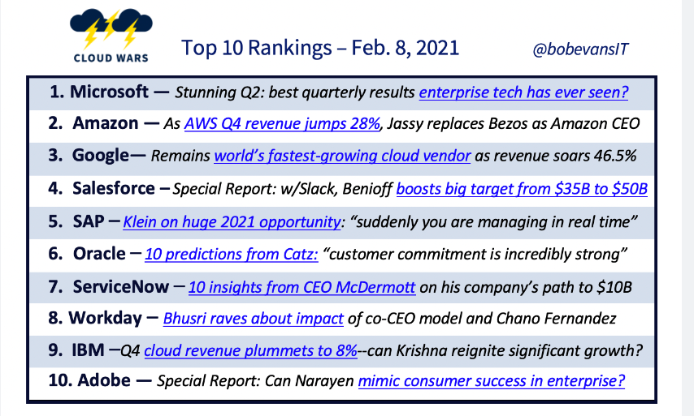
https://cloudwars.co/

Slide 19
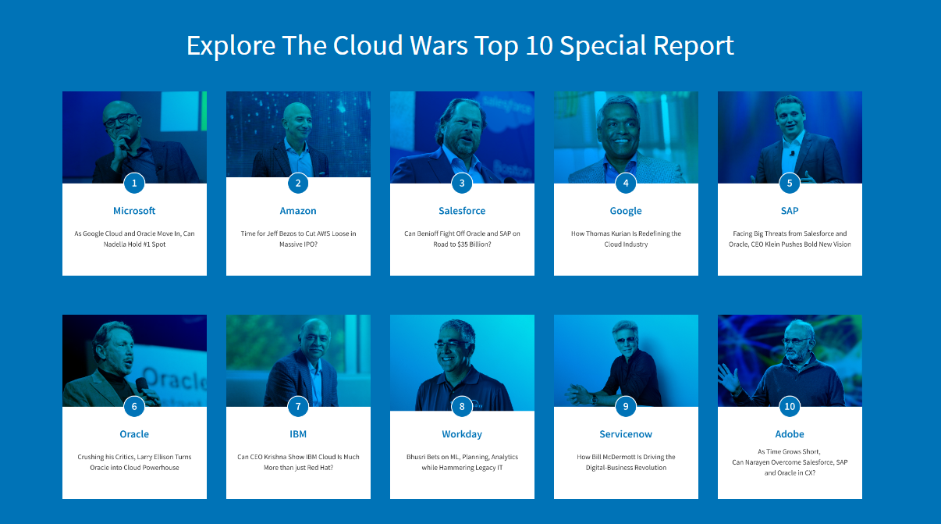
Heads in the Clouds

Slide 20
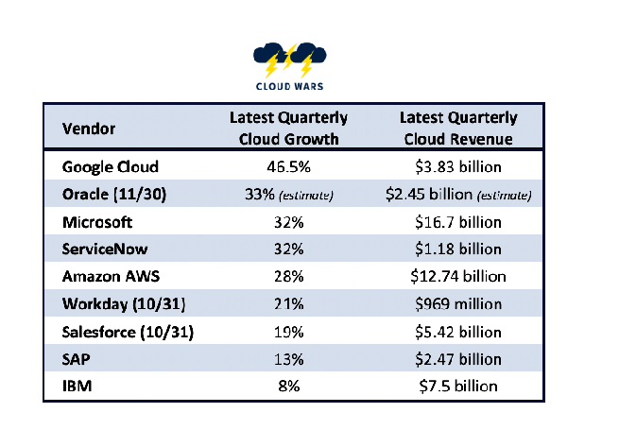
Fastest Growing for 2021
https://cloudwars.co/google-cloud/worlds-fastest-growing-cloud-vendors-q4-google-oracle/

Slide 21
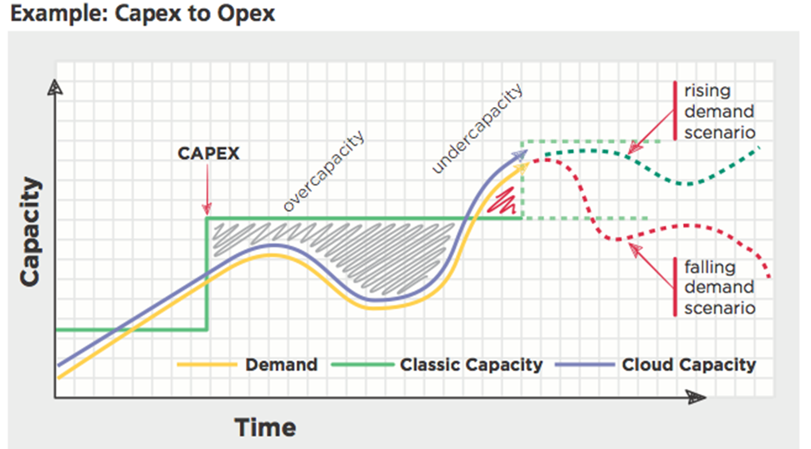
Measuring Clouds Value

Slide 22
Measuring Clouds Value
In the Previous Diagram we Can See the Following :
Initial Massive investment in Capital
Wasted Resources
Existing Resources Insufficient for Demand

Slide 23
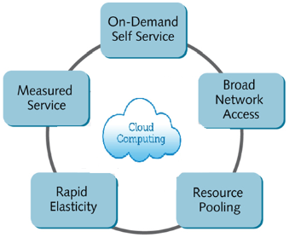
Cloud Characteristics
On-demand self-service.
Broad network access.
Resource pooling.
Rapid elasticity.
Measured Service.

Slide 24
Value Proposition
Measuring the Clouds Value
How Can We Measure the Clouds Value ?
8 Key Indicators :
The Speed and Rate of Change
Total Cost of Ownership Optimization
Rapid Provisioning
Increased Margin and Cost Control
Dynamic Usage
Risk and Compliance Improvement
Enhanced Capacity Utilization
Access to Business Skills and Capacity Improvement

Slide 25
The Speed and Rate of Change
Cost reduction and cost of adoption /de-adoption is faster in the cloud.
Cloud computing creates additional cost transformation benefits by reducing delays in decision costs by adopting pre-built services and a faster rate of transition to new capabilities.
This is a common goal for business improvement programs that are lacking resources and skills and that are time sensitive.

Slide 26
Total Cost of Ownership Optimization
Users can select, design configure and run infrastructure and applications that are best suited for business needs. Traditionally this has often been decoupled when IT projects are handed off to production services. In cloud computing environments these are joined up.

Slide 27
Rapid Provisioning
Resources are scaled up and down to follow business activity as it expands and grows or is redirected. Provisioning time compression can go from weeks to hours.

Slide 28
Increased Margin and Cost Control
Revenue growth and cost control opportunities allow companies to pursue new customers and markets for business growth and service improvement.

Slide 29
Dynamic usage
Elastic provisioning and service management targets real end users and real business needs for functionality as the scope of users and services evolve seeking new solutions.

Slide 30

Risk & Compliance
Cloud computing green capabilities can be leveraged through shared services.

Slide 31
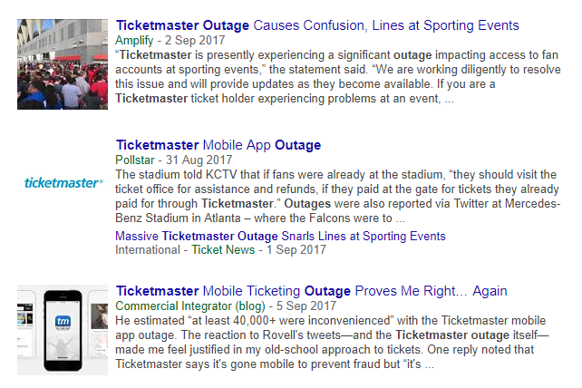
Enhanced capacity utilization
IT avoids over-and under-provisioning of IT services to improve smarter business services.

Slide 32
Access to business skills and capability improvement
Cloud computing enables access to new skills and solutions through cloud sourcing on demand solutions
Competitive Advantage

Slide 33
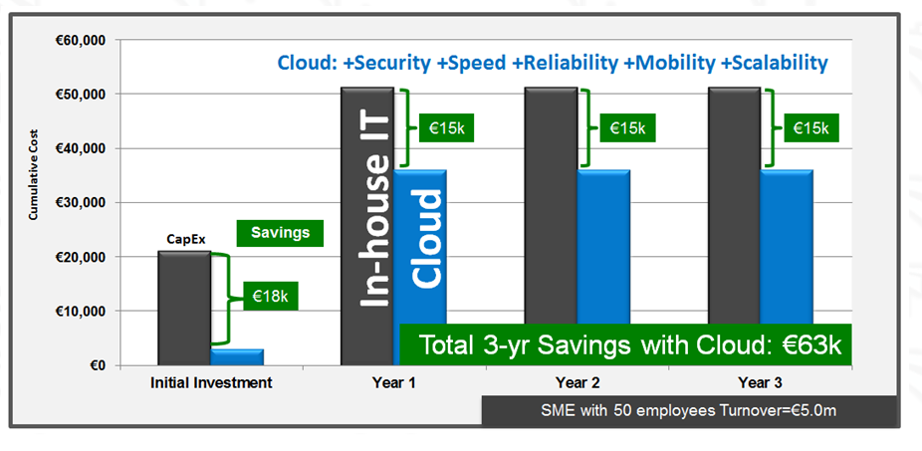
CapEx Vs OpEx

Slide 34
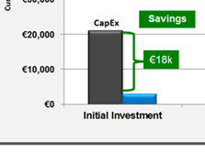
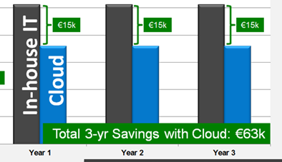
CapEx Vs OpEx
What Can We See in Our Previous Diagram
Massive Initial Capital Expenditure
Ongoing Re-Occurring Expenditure
- Licenses
- Power
- Rent
- Maintenance

Slide 35
Advantages of an on-premise solution ?
Total control – Contrary to a SaaS model, an on-premise solution offers total control over the software. All sensitive data is stored internally and there is no risk of exposing it to a third-party vendor. Unless of course the organization's IT is already source to a third-party.
Full ownership – Since the organization must purchase the infrastructure and resources for an on-premise solution, it offers a higher sense of ownership.
More customization — Often an on-premise solution enables more options for customizations that are outside the scope of the providers given API. For example it might be possible to create new screens, workflows, data-objects or other than what is initially provided by the vendor.

Slide 36
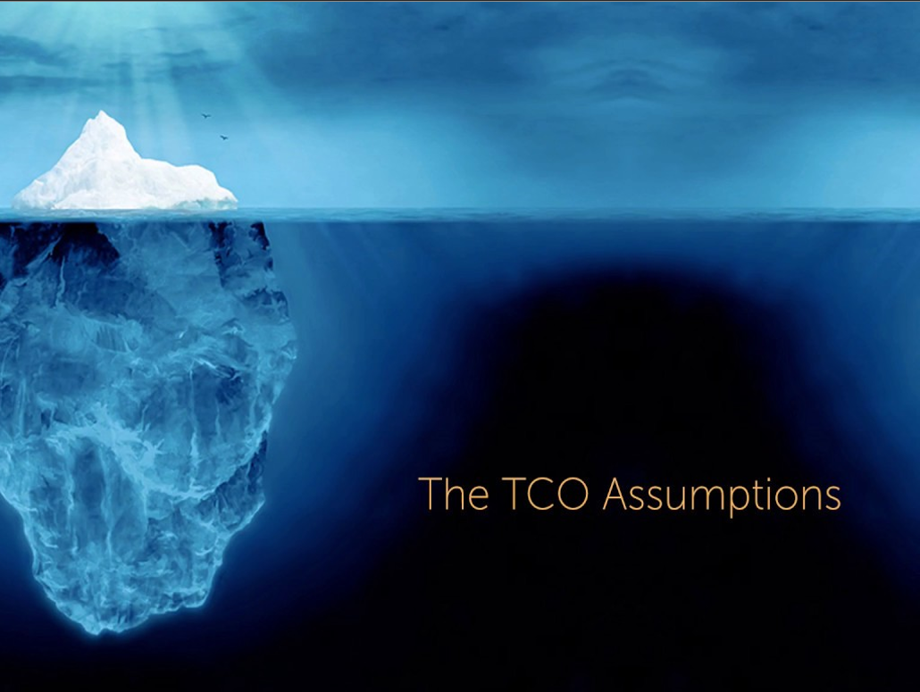

Slide 37
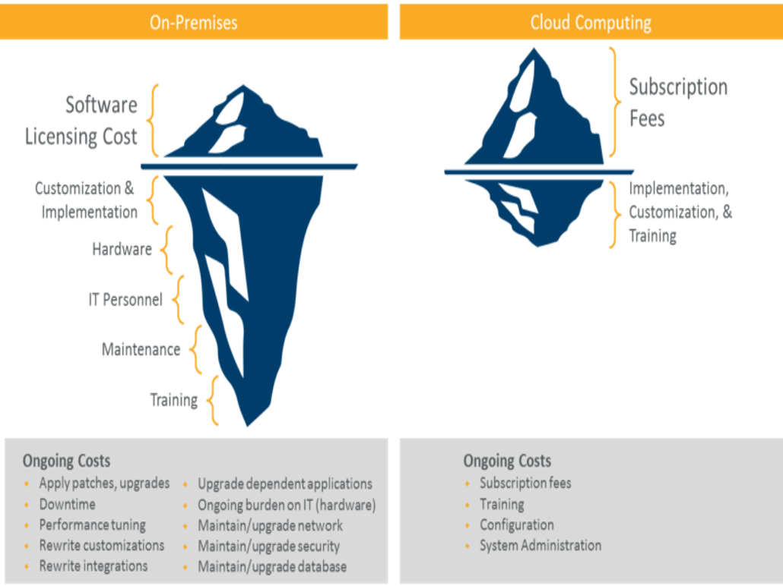

Slide 38
Value Proposition
Hidden Costs of cloud
Computing the total cost of ownership
Migration Costs
In House Cluster to a Cloud platform of One cloud platform to another
Over and under provisioning
Allocation of resources or under allocation

Slide 39
Value Proposition
Computing the total cost of ownership
Hidden Costs of cloud
Mismanagement of Complex Cloud deployments
Human error
Poor Code Deployments
Configuration Changes
Potentially Due to lack of Automation
Ultimately Resulting in a loss of revenue

Slide 40
Value Proposition
Computing the total cost of ownership
Hidden Costs of cloud
Free Cloud Resource Expiration
Limitations Over Run

Slide 41
Value Proposition
Computing the total cost of ownership
Hidden Costs of cloud
Unused resources
Clusters / Expanded / Detracted as required
Instances Left Spinning
Rogue instances - Devs

Slide 42
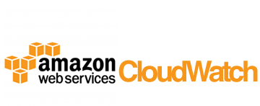
How To Avoid Some of These Pitfalls
Monitoring
https://aws.amazon.com/cloudwatch/
Automation

Slide 43

The Value of Cloud
The Utility Methodology
What does Utility Mean to you ?

Slide 44
The Value of Cloud
The Utility Methodology
What does Utility Mean to you ?
A Utility model that Provides Utility
the state or quality of being useful; usefulness:
We Pay As We Need!

Slide 45
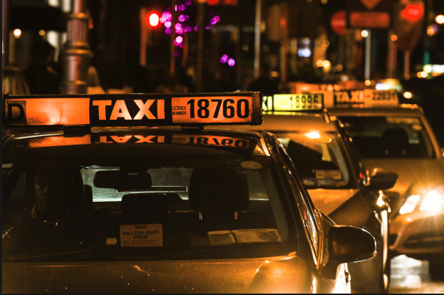
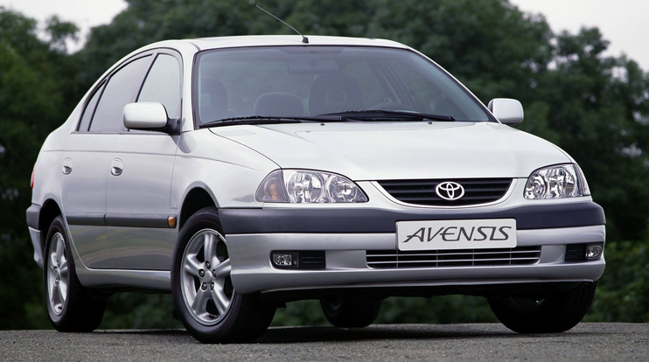
Value Proposition
Computing The TCO
Lets Do a Quick Break Out
Let Me Know the Costs associated and compare both TCO of utilizing a taxi service and having a car
Provide a Comparison of the TCO of using a taxi and those of owning a car

Slide 46
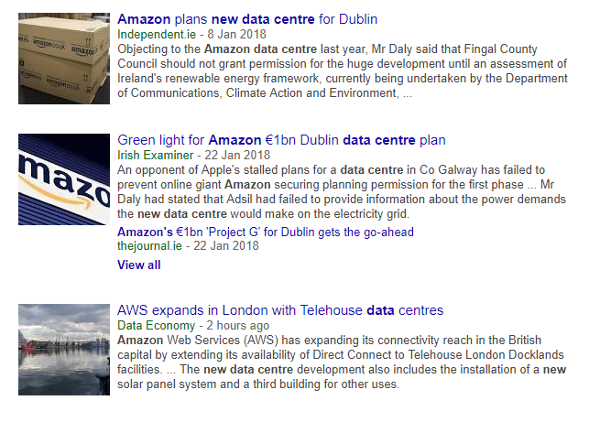
DC News
New data Centres in Dublin
Dublin the TechHub

Slide 47
Lab / Tutorial
The Physical Cloud – Under The Hood
Data Center Boom Ireland
https://www.youtube.com/watch?v=3CnnIfApUbY
Inside a Google Data Center
https://youtu.be/XZmGGAbHqa0
What is the most innovative part of this data centre design?
What are the Key Considerations with DCs
Energy / Security / Reliability ?

